Slide 1
Company details

Slide 2
Supercar company
Name: Supercar company
How long on the market: <1 year
Company description: The company creates cars for everyone
Product Description: Excellent car, which is so comfortable, speed, with new technologies
Problem: Nobody buys that car
Contracts: None

Slide 3
Super marketing company
Name: Super marketing company
How long on the market: >50 year
Company description: The company creates ads for business
Products Description: Market analysis, creating advertising, providing brand to customers
Contracts: 100+ contracts with different companies
Service: Can help with selling products

Slide 4
Problem of BN

Slide 5
Problem of negotiations
Creating a marketing strategy for Supercar company to create the brand closer to customers and to provide product

Slide 6
Business interest
Supercar
sell cars and earn 1 million $
Super marketing
create a long-term contract with Supercar company

Slide 7
Common interest
Supercar
marketing helps generate 1 million customers and fans
Super marketing
assign the long-term contract and add a case to the portfoli

Slide 8
Business expectations
Supercar
marketing helps generate 1 million customers, and they will be on the top
Super marketing
assign a long-term contract and will earn money during that contractassign a long-term contract and will earn money during that contract

Slide 9
Professional value
Supercar
can create cars
Super marketing
can create ads and provide a product to future customers

Slide 10
Team members

Slide 11
Supercar company
Character of business team

Slide 12

General director
Negotiation character - The tactics of delaying
That person prefer listening instead of saying, he thinks that his product should say about his success, that’s main reason why he chose that character of negotiations. Also, when you are listening you may know more

Slide 13

Financial director
Negotiation character - The tactics of false rejection
Her main goal is save money and she does not care how to achieve the goal, sometimes she reject the offer for getting better proposal.
Also, when you are reject an offer – you may know something interesting about service, may receive additional service and so on

Slide 14
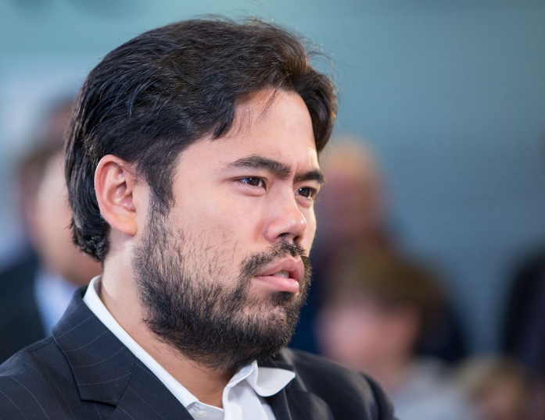
Engineer
Negotiation character - The tactics of fait accompli
That person prefer facts as arguments, he actually say about product and nothing else

Slide 15
Supermarketing company
Character of business team

Slide 16

General director
Negotiation character - The tactics of "salami“
He wants to sell as much as possible count of services, he propose one main service and add additional services and explain their addvanatges

Slide 17

Financial director
Negotiation character - The tactics of fait accompli
Because she works at marketing company, she has already know some manipulation features, that main reason, why she said ‘you bought‘ instead of ‘that service cost’
She is a manipulator

Slide 18
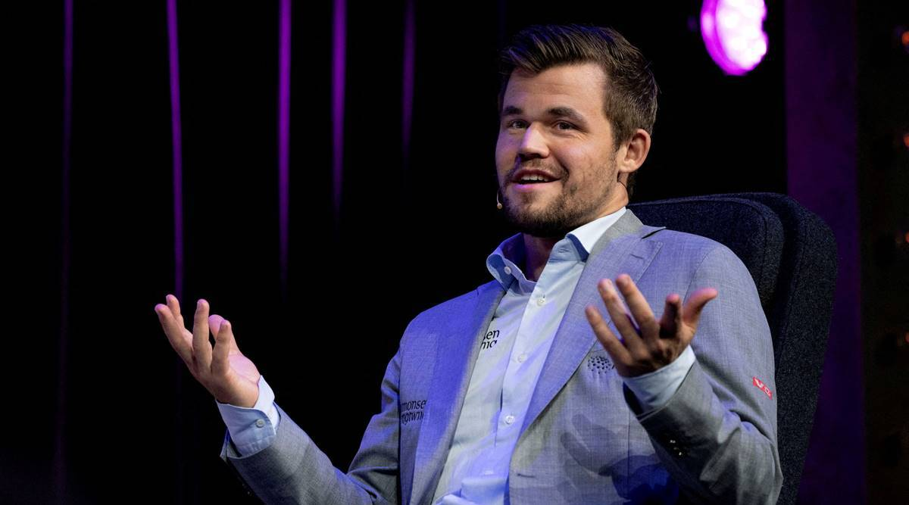
Ads creator
Negotiation character - The tactics of surprise
His main goal is create ads, so that main reason, why he is so spontaneous and it helps him to create an ads

Slide 19
Starting point

Slide 20
Preparation
Supercar company
They have to prepare to negotiations, add goals, main points, what they want from other company, which result they want and so on
Super marketing company
They have to prepare to negotiations because, they need to know product of other company, know main features of product, possible strategy of ads and so on

Slide 21
First contact
Supercar company
It creates two things – establishing a cordial relationship and presenting the objectives of the negotiations
Super marketing company
Establishing a cordial relationship and presenting the objectives of the negotiations is so important, because, you have only one chance to make a good impression

Slide 22
Key points of BN

Slide 23
Issue of the agenda in the scenario

Slide 24
Organization issue

Slide 25
Super car company has organization issue
Engineer left main info about car
Solution – explain main details without documents and propose to send documents for work later
The light power was destroyed
Solution: propose to reschedule meeting
Translator was stuck in a lift
Solution – try to start with a google translate

Slide 26
Super marketing company has organization issue
Marketing tools was broken
Solution: Propose to use that tool later
The light power was destroyed
Solution: propose to reschedule meeting
General director was late
If online meeting, then it’s general
If offline – propose discount

Slide 27
Financial issue

Slide 28
Super car company has financial issue
Finance account was frozen
Solution – propose to start work (from oponent), when account is unfreeze
Price of service is more, than expected
Solution - propose to take a break for thinking and schedule new meeting
Solution – propose to decrease count of service

Slide 29
Super marketing company has financial issue
Service was not paid
Solution – if it’s bank issue (payment in progess) – start working on some tasks
Solution – if was not paid – start working, but don`t take the result

Slide 30
Special issue

Slide 31
Super car company has special issue
Factory was closed, because corona virus in China
Solution – say about it and change main auditory from everyone to luxury

Slide 32
Super marketing company has special issue
Marketing director was put in prison for marketing company
Solution – explain problem and say, that was the best marketing company, because everyone know about it

Slide 33
Three main tactics and rhetorical methods

Slide 34
Supercar company
Method: Avoid logical fallacies
Tactic: Similes
Why: It may help with explaining main features and how it may be provided for the future customers. Also, it may help to explain some details for opponent and it may create some logo for the company, for example, car “Mini” is England car, however it was bought by Volkswagen and right now it’s Germany’s car, but customers know it as England

Slide 35
Super marketing company
Method: Logos
Tactic: Alliteration
Why: The company may explain services with alliteration and with examples on other companies, which is already in our brain. And it may help to decide what may be the best for ads and for product. Also, it may create some logo for the company and it may help to create unic style and unci ad For example Volkswagen in each their ads added phrase ‘Volkswagen Das Auto’ and everyone know it, so if some logo will be created during negotiations, that’s perfect

Slide 36
W. Ury strategies

Slide 37
Separate the people from the problem
In negotiation, it's easy to forget that our counterparts have feelings, opinions, values, and unique backgrounds that contribute to what they do and say during talks.
Strive to imagine the situation from their counterpart's viewpoint.
If someone is refusing to back down from a hardliner position, ask her how she thinks things are going.

Slide 38
Focus on interests, not positions
We tend to begin our negotiation by stating our positions.
When we stake out firm positions, we set ourselves up for an impasse.
By identifying what interests are motivating the other party, and sharing your own interests, you can open up opportunities to explore trade offers across issues and increase your odds of getting to yes.

Slide 39
Learn to manage emotions
Be sure that you and your counterpart have ample opportunities to express and discuss any strong emotions related to their negotiation.
Allowing one another to speak their mind will benefit both sides.
When you know that you will have your turn to express how you're feeling, it will be easier for you to listen when your counterpart has his turn.

Slide 40
Express appreciation
At the vanguard of integrative negotiation, Fisher stressed the importance of expressing appreciation as a means of breaking through an impasse.
"No one likes to feel unappreciated, and this is particularly true in a negotiation".
Express appreciation by working to understand the other's perspective, seeking merit in that perspective, and communicating understanding through words and actions.

Slide 41
Put a positive spin on your message
Communicating in a positive way is a much more effective means of getting to yes than blaming and criticizing.
Instead of speaking on behalf of your group, speak only for yourself.

Slide 42
Escape the cycle of action and reaction
In Getting to Yes, Fisher, Ury, and Patton caution us to avoid the common negotiation trap of action and reaction: "If the other side announces a firm position, you may be tempted to criticize and reject it."
To head off this vicious cycle, Fisher, Ury, and Patton introduce a negotiation skill that involves avoiding escalation by refusing to react.

Slide 43
The strategy allows partners to use 2 scenarios.
The general problem of starting the second scenario is the level of saved relationships after the first scenario, the else problems can be if the reason for failing first scenario is tthe reaction on a strong position.
In two this major problems "6. Escape the cycle of action and reaction" strategy will help to try something new in negotiations

Slide 44
Strategy that helps to choose the adequate tactics

Slide 45
Focus on interests, not positions
The general problem to choose adequate tactics is to rightly evaluate the interests and values of your partner. "2. Focus on interests, not positions" strategy will help with that a lot.

Slide 46
Result of business negotiations

Slide 47
Supercar company
Earn 1 000 000$ after contract with Super marketing company
Earn more funs in social media
Super marketing company
Has perfect case in portfolio
Ads helped earn money for Supercar company

